Slide 1

E-Charge
Stations
https://echargestations.infinityfreeapp.com/
Fnu Abdullah
Joseph
Kiran
Vibhav

Slide 2
Introduction & “The” Problem
E-ChargeStations is a web-based platform designed to connect electric vehicle (EV) users with charging station hosts.
EV adoption is growing, hence users often:
Struggle to find available stations nearby.
Want an easy way to book/reserve EV stations.
Prefer a marketplace-style browsing experience.
We solve these problems with our ECharging stations website
Need for more accessible and affordable charging options. Our platform bridges this gap by allowing homeowners and businesses to list their private charging stations for public use.

Slide 3
Project Structure & Design
Server
Client
Hosted on InfinityFree (https), responsible for serving requests and managing logic. WordPress Core (PHP), WooCommerce for shop functionality
Web-based front end built using WordPress (customized), PHP, HTML5, CSS3, JavaScript.
Database
WordPress MySQL DB to store users, bookings, charging stations, etc. managed by InfinityFree

Slide 4
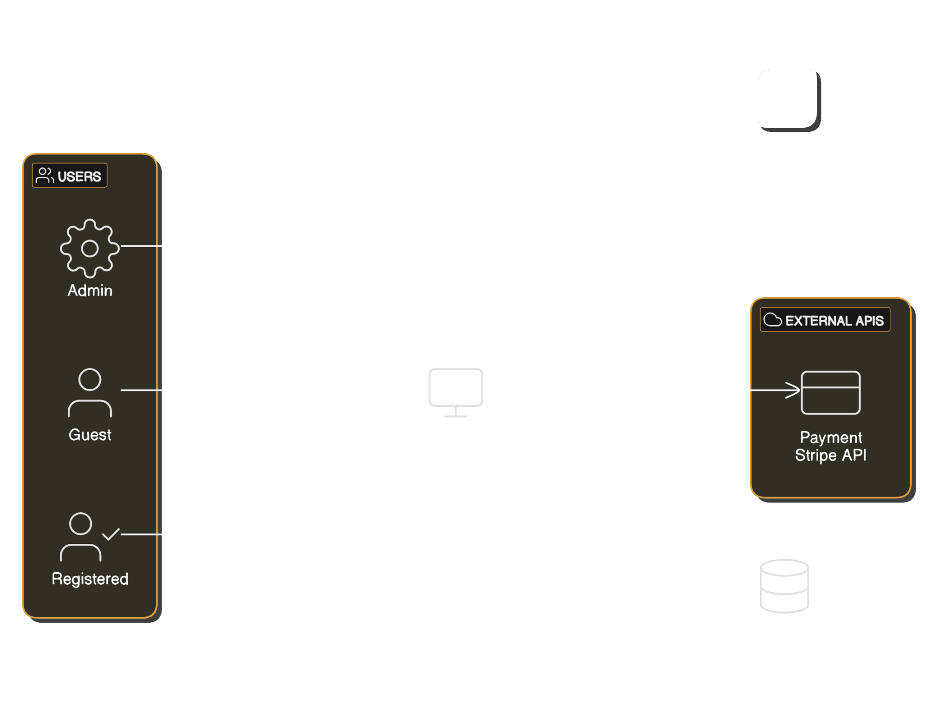
Data Flow Diagram

Slide 5

Data Flow Diagram

Slide 6
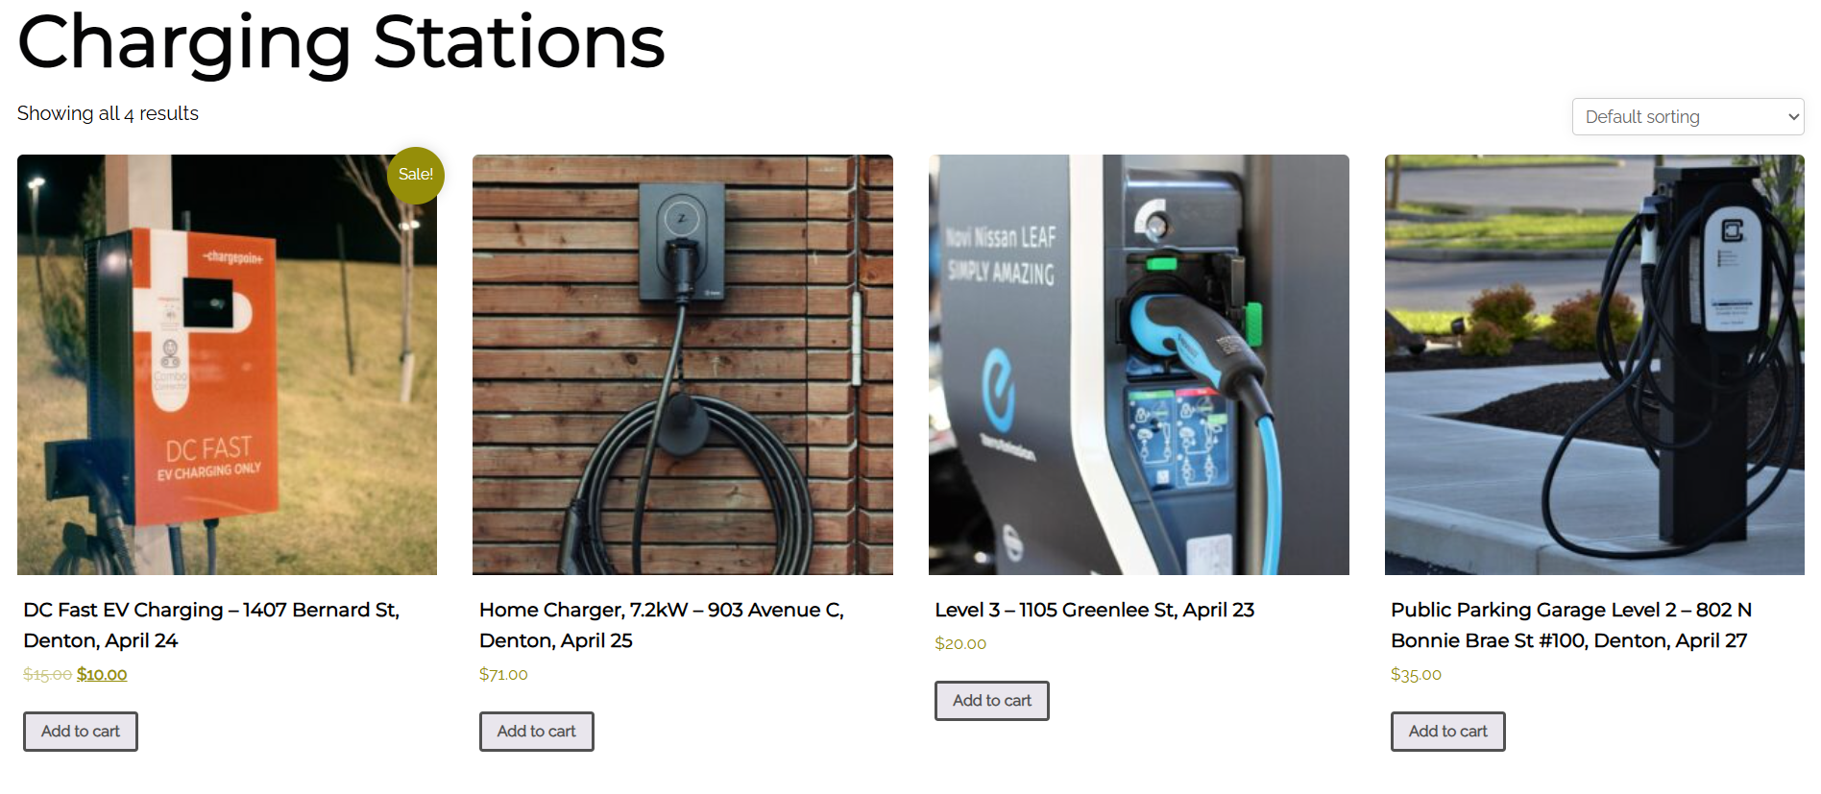
Key Features
Business and Customer users
Business user registration with email verification and MFA
Browsing and booking charging stations
Business dashboard to manage listings
SSL enabled for secure transactions
Secure login system

Slide 7
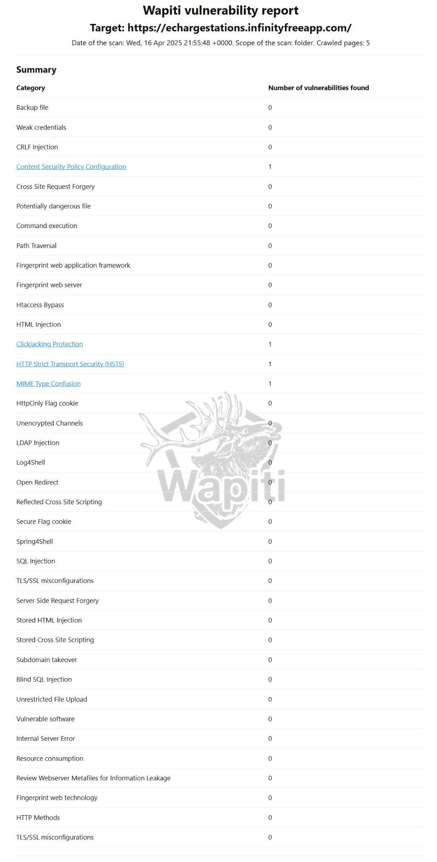
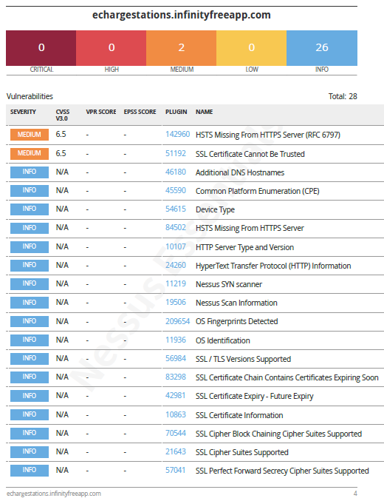
Results and Analysis
Vulnerability Assessments:
Nessus
Wapiti
WPScan
Security:
Input Validation
reCAPTCHA
Email Verification
SSL
MFA (Google)
Mail Server
Payment – Stripe
WordFence
Shield Security

Slide 8
Conclusions
Developed a full-fledged online platform for EV charging stations
Ensured a secure deployment
Payments and Security
Built with scalability and real-world use cases in mind

Slide 9
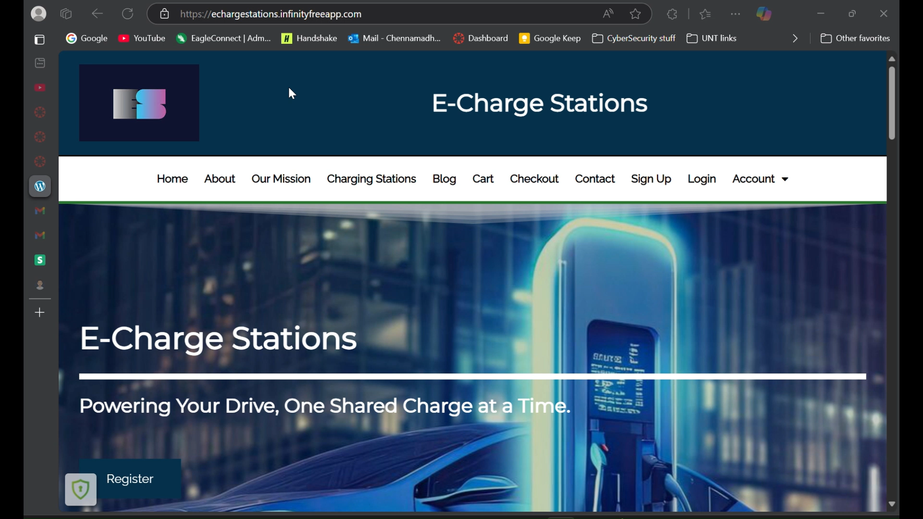
Live Demo Of Echarging Stations

Slide 10
References
WordPress Developer Docs https://developer.wordpress.com/docs/
Stripe API Documentation https://docs.stripe.com/
Nessus Vulnerability Scanner – https://www.tenable.com
Wapiti Web Scanner – https://wapiti-scanner.github.io/
OWASP ZAP – https://owasp.org/
Kali Linux Security Tools – https://tools.kali.org/
WPScan – https://wpscan.com

Slide 11
Thank You!

